Slide 1
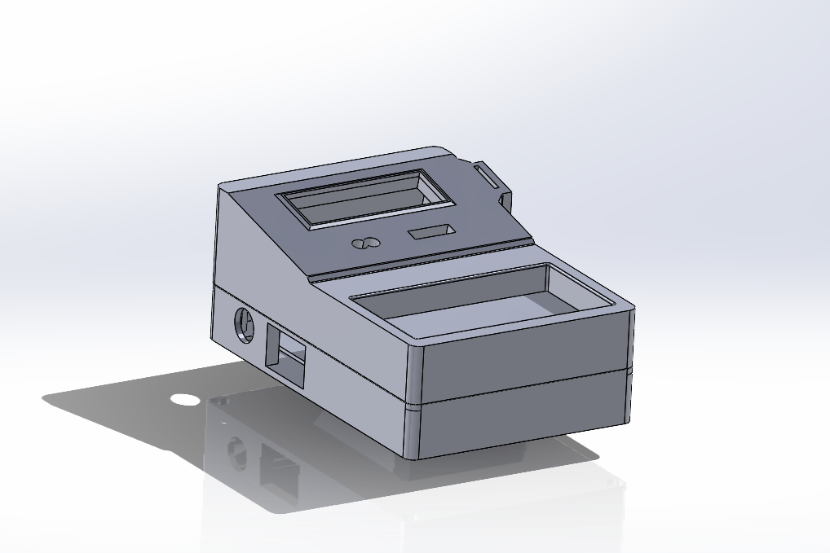


Portable Soldering Station
Jop de Jong
1

Slide 2
Portable Soldering Station
A portable battery-powered soldering station, convenient for soldering in any location.
2

Slide 3
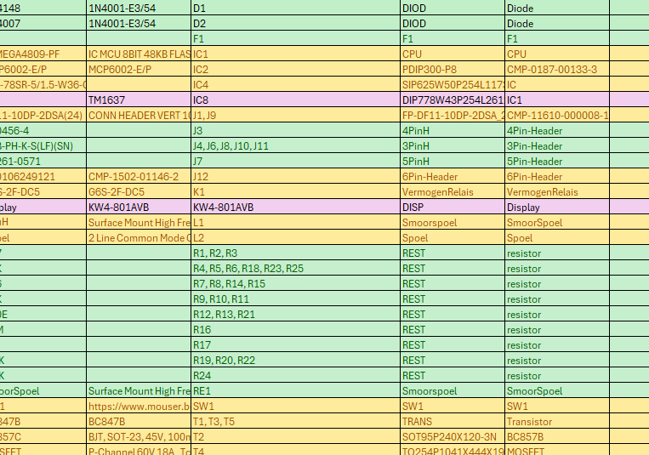
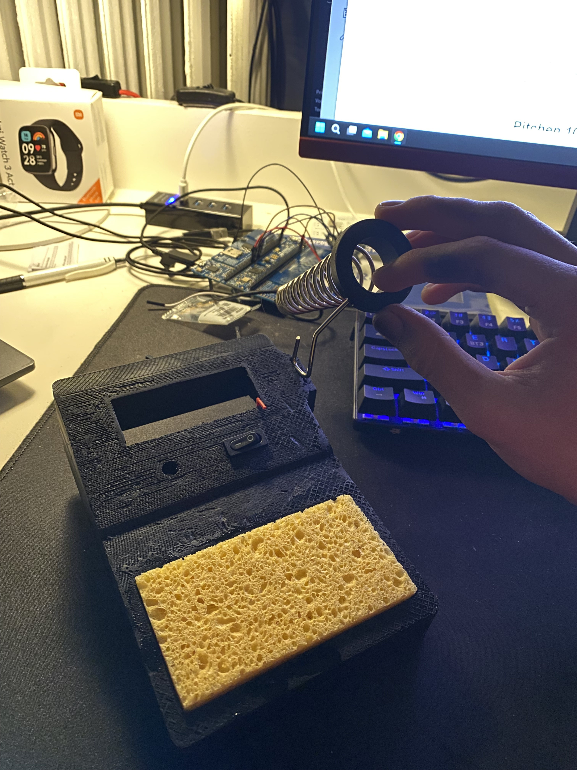
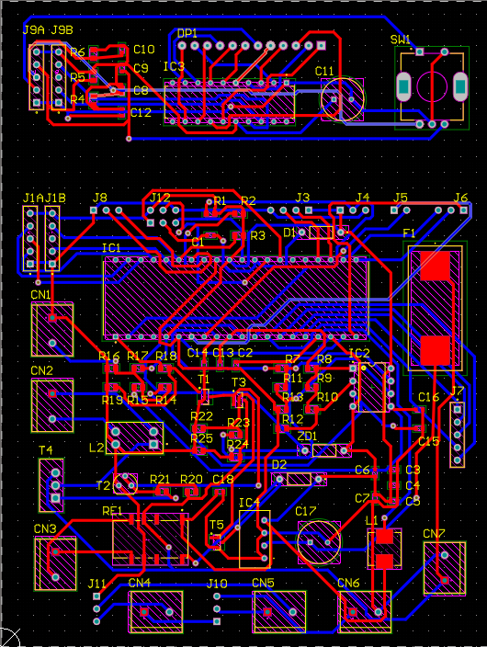
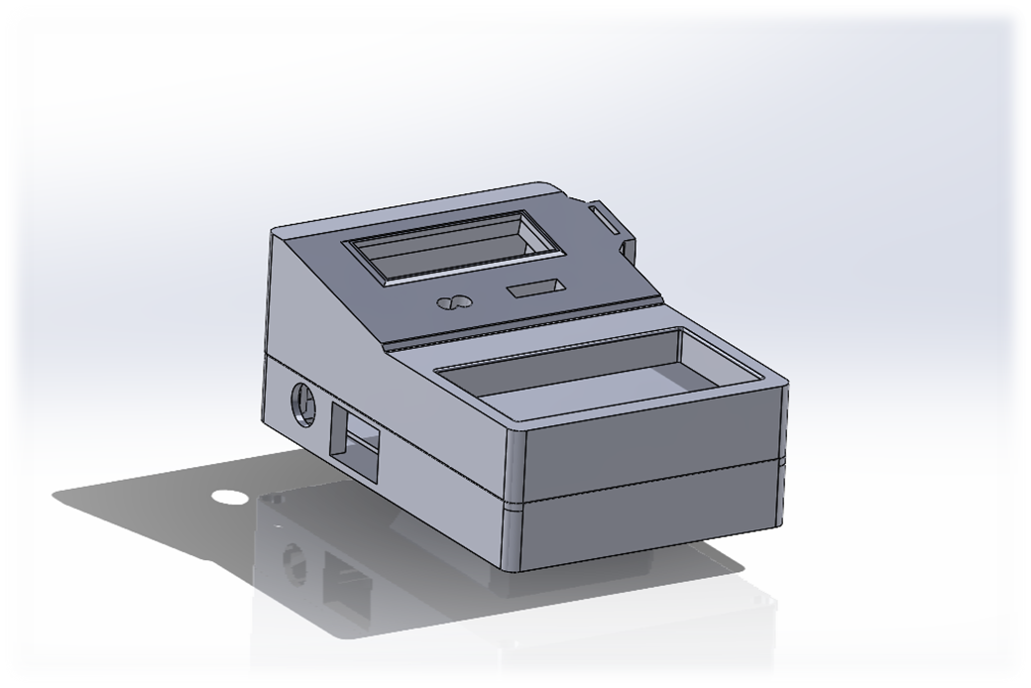
PROCESS
Components
Testing
BOM File
Comparing Websites
Testing all functions
Altium
Case Design
PCB Design
Manufacturing Files
Solidworks
3

Slide 4
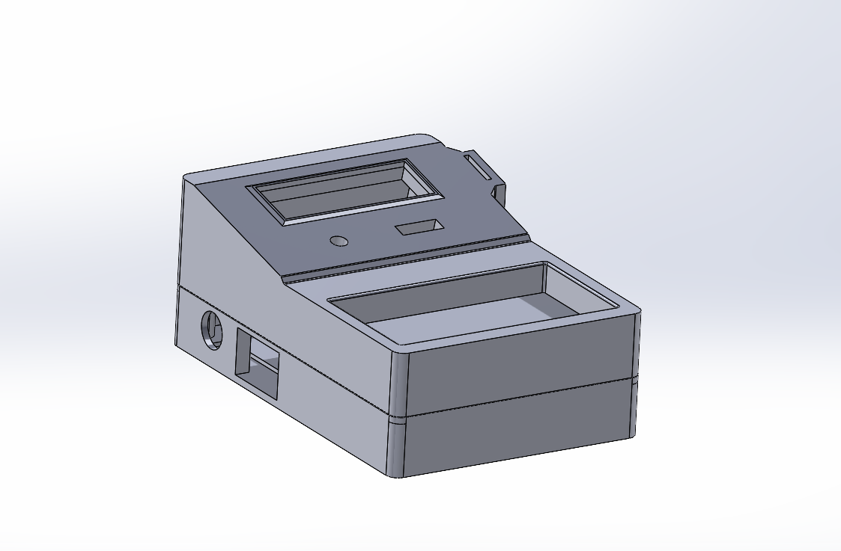
CASE
A strong 3d-printed case
Easy to transport and lightweight
4 screw disassembly for quick repairs

Slide 5
COMPONENTS
Inexpensive and reliable components that are easily replaceable
5

Slide 6
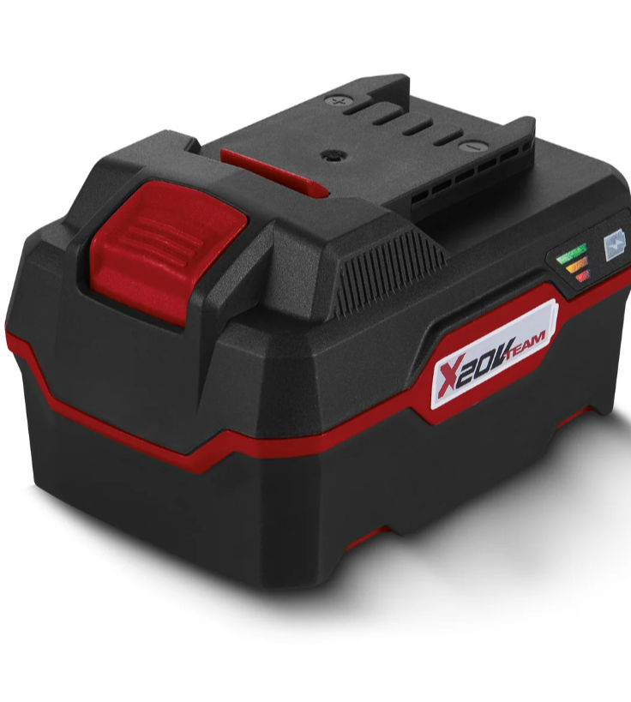
BATTERY
An affordable battery that is long-lasting and rechargeable

Slide 7
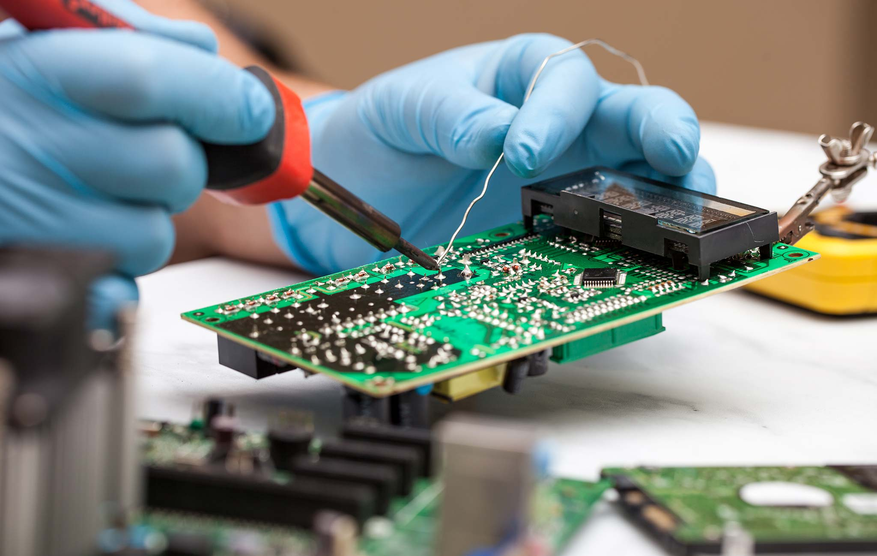
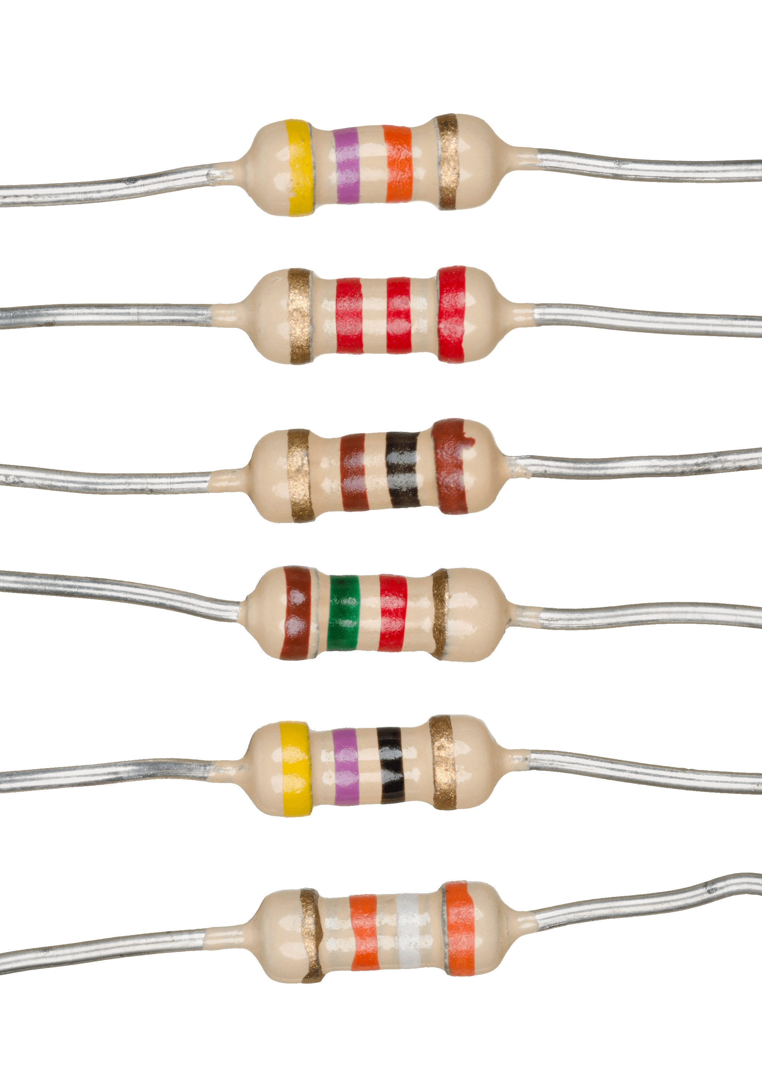
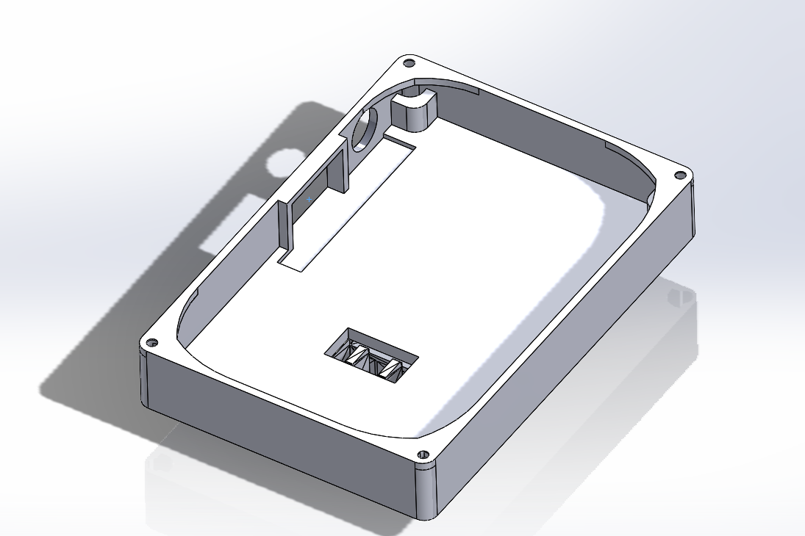
ASSEMBLY
Soldering
Last Adjustments
Soldering Components
Identifying Errors
Components
Case Fitting
Order components
PCB Placement
7

Slide 8
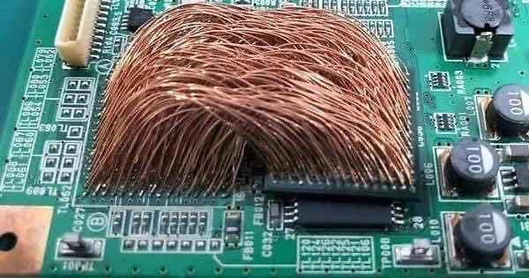
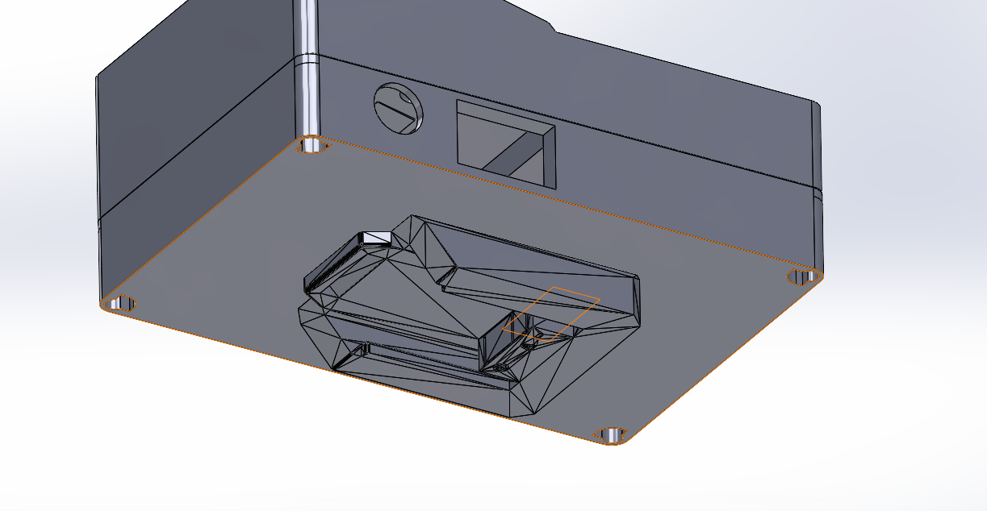
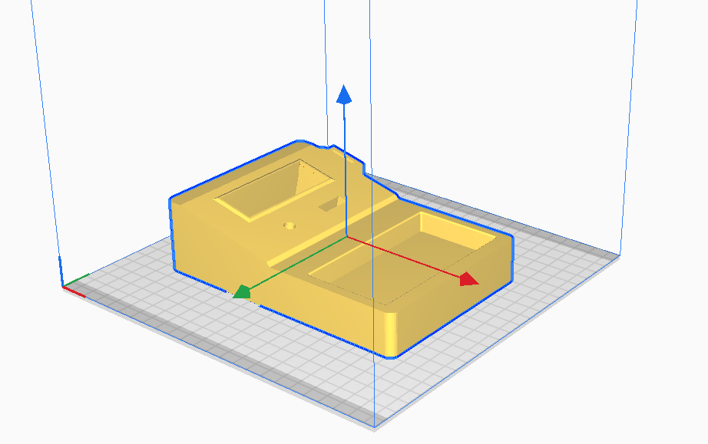
Thank You
8

